Slide 1
Topic: Measurement EQ: How do I calculate between non-metric units of measurement?
Year 11 Essentials

Slide 2
Things Required For This Lesson
Interactive Notebook
Textbook: Interleaved Maths Essential Connections
Ruler, Red Pen, Pencil, Pens, Scientific Calculator
Growth mindset

Slide 3
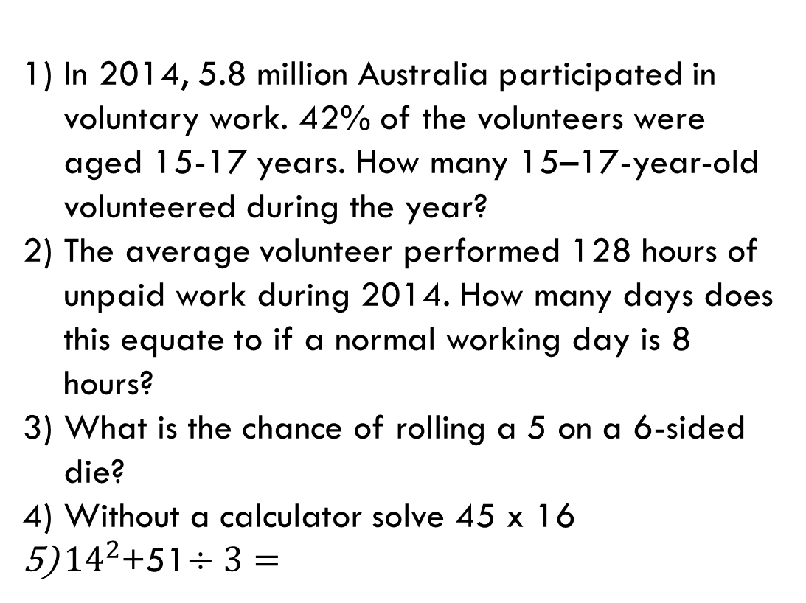
First 5
Answers
1) 2 436 000
2) 16 days
3) 1:6
4) 720
5) 213
In 2014, 5.8 million Australia participated in voluntary work. 42% of the volunteers were aged 15-17 years. How many 15–17-year-old volunteered during the year?
The average volunteer performed 128 hours of unpaid work during 2014. How many days does this equate to if a normal working day is 8 hours?
What is the chance of rolling a 5 on a 6-sided die?
Without a calculator solve 45 x 16
${14}^{2}$+51$÷3=$

Slide 4
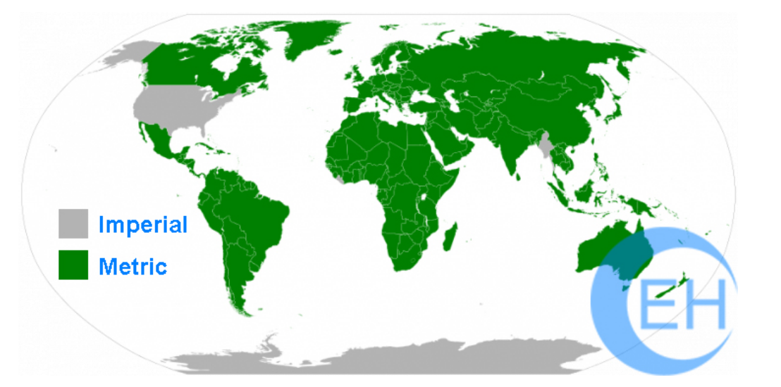
24
7
30
Topic: Measurement
EQ: How do I calculate between non-metric units of measurements?
What is the difference between the Metric and Imperial systems?
Metric System – used by most countries and has
which uses measuring units such as meters and grams and adds prefixes like kilo, milli and centi to count orders of magnitude.
Imperial System – used in the United States, people use the older Imperial system, where things are measured in feet, inches, and pounds.
WICOR

Slide 5
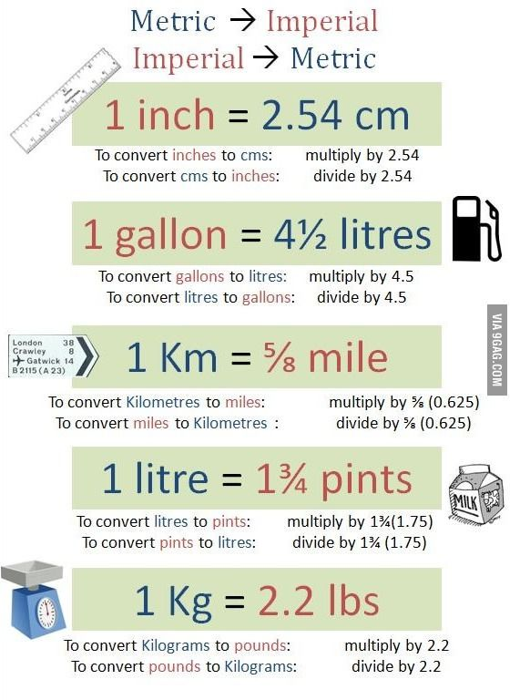
24
7
30
Topic: Measurement
EQ: How do I calculate between non-metric units of measurements?
How to convert between the metric and imperial system?
WICOR

Slide 6
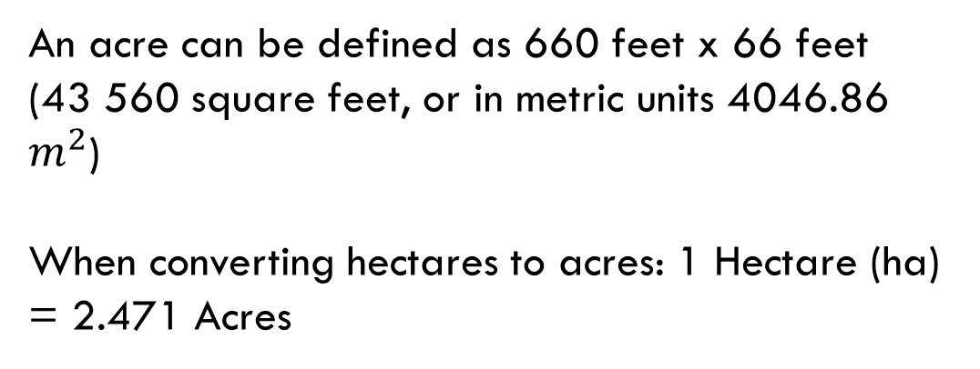
24
7
30
Topic: Measurement
EQ: How do I calculate between non-metric units of measurements?
How to convert between acres and hectares?
An acre can be defined as 660 feet x 66 feet (43 560 square feet, or in metric units 4046.86 $m^{2}$)
When converting hectares to acres: 1 Hectare (ha) = 2.471 Acres
WICOR

Slide 7
Page 66
Complete Explore and Evaluate sections in your book
Fermi Problem
1) How long would our class have to save to buy a car?

Slide 8

Thank you
Keep up the good work!

